Slide 1
Stage 5: Researching consumer preferences

Slide 2
Learning Objectives:
To design and conduct a survey
To present data in a bar chart
Market research is used by grown-up businesses to help them find out what their customers need and like.
We can use it to find which flavour of tartlet or breakfast drink our customers would prefer.
Why do you think we need this information?

Slide 3
Market Research
For our survey, we need to ask a short question that can only be answered by selecting one of the possible answers.
For example, which flavour of tartlet would you prefer? Tomato and red pepper or mushroom and parsley?
By asking our participants to choose the food product option they would like the most out of your ideas, we will be able to decide if people will want to buy our products or not. This will help us make a final decision about what to make.

Slide 4
Task 1: collecting data
Write your research question. For example: Which flavour of tartlet is the most popular with children in our class?
Ask as many children as possible and record your results using a tally chart.
Think about your Year 3 learning: what is a tally chart?

Slide 5
Tally charts
Tartlet flavour | Tally
Tomato and red pepper
Spring onion and mushroom
Ham and chive
Salmon and watercress
2. Each time someone votes for a flavour, make a tally mark in the tally column.
For your fifth tally mark, draw your line through your first 4 tally marks.
1. Draw a table with 2 columns. One is for your tartlet flavour ideas and the other is for how many children voted for them.

Slide 6
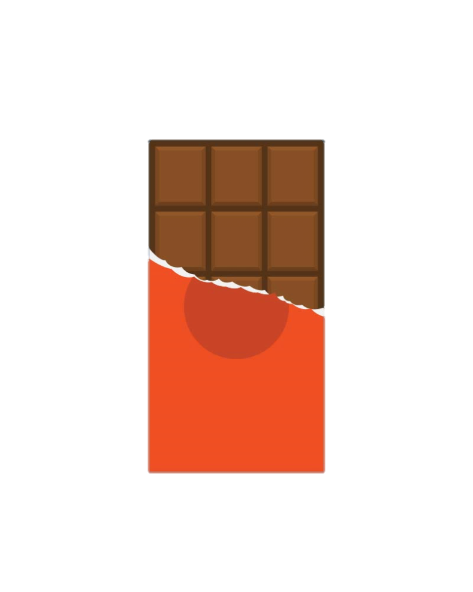
Task 2: Chocolate bar challenge!
Fill one of the squares on your chocolate box with a fact that you can remember about bar charts from Year 3.
Move around the room and collect facts from your friends. When they tell you their fact, you must give them your fact and both of you can then add your new facts to your chocolate boxes.
Continue to swap facts with your classmates until your chocolate bar is full of delicious bar chart facts!
3. Add a key.

Slide 7
Task 3: Drawing a bar chart
All bars have equal widths.
There is a gap between each bar.
Bars can be drawn horizontally or vertically.
- When deciding on a scale, look at the data you have collected to see how large your range is.
Your scale should go up in regular intervals.
Remember to use a ruler!
A bar chart is used to display discrete data.

Slide 8
What title should we give this bar chart?
Spaces between
bars
Bars can be vertical or horizontal
Number of votes
The scale increases in regular intervals
Flavour
Discrete categories

Slide 9
Spaces between
bars
What title should we give this bar chart?
Bars can be vertical or horizontal
The scale increases in regular intervals
Discrete categories

Slide 10
Task 4: Making your final decision
Discuss your results with your group and make a final decision about the healthy lunchtime food product that you will produce.
You may choose the most popular product from your market research or you may wish to appeal to a specific group of participants (this is called a niche market).
For example, if your results showed that Year 4 boys stronger prefer tomato tartlets, you could decide to make that flavour and package and advertise your product in ways that you think would appeal to Year 4 boys.

